Slide 1




EMBO Practical Course on
Computational analysis of protein-protein interactions: Sequences, networks and diseases
5th May - 10th June 2018
Rome, Italy
PPI 3D complex prediction and interfaces
(What we talk about when we talk about docking)
Allegra Via
Institute of Molecular Biology and Pathology
National Research Council, Italy
Friday, 9th Novembre 2018

Slide 2
Hexameric PilT motor protein complex from P. Aeruginosa
PDB: 3JVV
http://www.ebi.ac.uk/pdbe/about/news/powerful-little-motor

Slide 3
Why predicting protein complexes?

Slide 4
Interface of the PilT domains with arginine residues shown in orange sticks and ATP analog shown in green

Slide 5
Molecular docking

Slide 6
Molecular docking: an optimisation problem

Slide 8
DOCKING = put a ligand in the pocket ( = best torsions) + maximise its affinity
Step 1: Pose generation
Conformational space search
Step 2: Scoring
Ranking of potential solutions

Slide 9
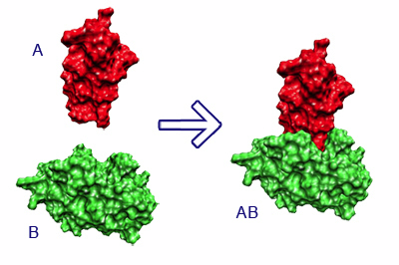
The docking problem
Given the atomic coordinates of two molecules, predict their “correct” bound association
receptor
receptor-ligand complex
ligand

Slide 10
Which ligands?

Slide 11
Protein-ligand interactions
elemental ions
small molecules
peptides
macromolecules

Slide 12
Three classes of docking
Protein-small molecule
Lot of flexibility
Binding sites tend to be small and deep
Protein-peptide
8-10 amino acids
Floppy backbones
Protein-protein
Stable backbones
Binding interfaces tend to be large and flat

Slide 13
Where do we start?

Slide 14
Ideally: a GOOD crystal structure
Usually worse: a homology model
A ligand, usually: the co-crystallised molecule

Slide 15
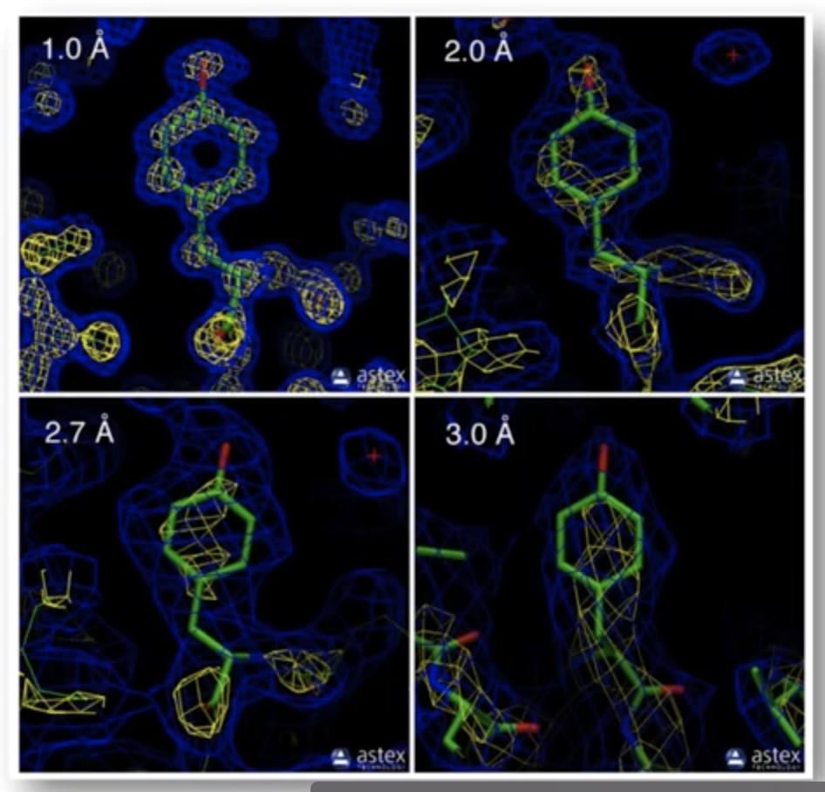
Ideally: a GOOD crystal structure
Usually worse: a homology model
A ligand, usually: the co-crystallised molecule

Slide 16
Ideally: a GOOD crystal structure
Usually worse: a homology model
A ligand, usually: the co-crystallised molecule

Slide 17
Ideally: a GOOD crystal structure
Usually worse: a homology model
A ligand, usually: the co-crystallised molecule
Please remember: an X-RAY/PDB structure is also just a «modelled» snapshot by a crystallographer
there is human intervention… not the holy experimental truth

Slide 18
The PDB educational portal
https://pdb101.rcsb.org/learn/guide-to-understanding-pdb-data/introduction

Slide 19
Ideally: a GOOD crystal structure
Usually worse: a homology model
A ligand, usually: the co-crystallised molecule

Slide 20
Ideally: a GOOD crystal structure
Usually worse: a homology model
A ligand, usually: the co-crystallised molecule
Bound docking: artificial separation of receptor and ligand
Goal: reconstruct the native complex

Slide 21
Ideally: a GOOD crystal structure
Usually worse: a homology model
A ligand, usually: the co-crystallised molecule
Bound docking: artificial separation of receptor and ligand
Goal: reconstruct the native complex
No conformational changes are involved
Used as first test to validate the algorithm

Slide 22
«Unbound» or «predictive» modelling
reconstruct a complex using the unbound structures of the receptor and the ligand
Halperin et al. Proteins, 2002

Slide 23
An "unbound" structure may be:
native
pseudo-native
modelled
Native: free in solution, in its uncomplexed state
Pseudo-native: structure complexed with a molecule different from the one used for the docking
Halperin et al. Proteins, 2002

Slide 24
Unbound docking is far more complex than bound docking
What are the issues?

Slide 25
conformational changes (side-chains and backbone movements)
experimental errors in the structures
reliability of models

Slide 26
Step 1: Pose generation
Conformational space search
Step 2: Scoring
Ranking of potential solutions

Slide 27
Step 1: Pose generation
Conformational space search
OR
Getting the ligand into the pocket
Translation & Rotation of ligand needs to be performed
=> An optimisation problem in T and R space

Slide 28
Bond distances & angles in principle known BUT torsions will have to adapt to put the ligand into the pocket
How the confromation will look like?
=> An optimisation problem in T space

Slide 29
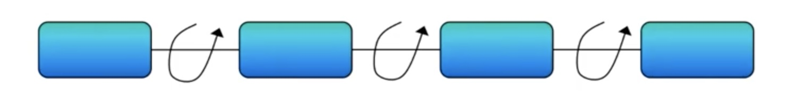
Conformational space search: torsions will kill us!
100 valid angles => 100³ = 1.000.000 points to evaluate it
Let’s assume: 1 sec per evaluation…
1.000.000/60 = 16.666 mins = 278 hrs = 11 days

Slide 30
Rigid vs flexible docking
Rigid body - highly simplistic model - receptor & ligand two rigid solid bodies
Semi-flexible - ligand flexible, receptor rigid
Flexible docking – both molecules flexible, BUT flexibility is limited or simplified

Slide 31
Rigid vs flexible docking
Rigid body - highly simplistic model - receptor & ligand two rigid solid bodies
Semi-flexible - ligand flexible, receptor rigid
Flexible docking – both molecules flexible, BUT flexibility is limited or simplified

Slide 32
Rigid vs flexible docking
Rigid body - highly simplistic model - receptor & ligand two rigid solid bodies
Semi-flexible - ligand flexible, receptor rigid
Flexible docking – both molecules flexible, BUT flexibility is limited or simplified

Slide 33
Docking algorithms
Rigid docking
fast → can explore the entire receptor and ligand surfaces
Less accurate
flexibility = "soft" belt into which atoms can penetrate
Flexible docking
Slower
More accurate
Can model side-chain/backbone flexibility
highly reliable but too slow for extensive ligand docking

Slide 34
Conformational space search
Efficient search algorithm – fast and effective in covering the relevant conformational space
Computationally difficult - there are many ways to put two molecules together
Goal: locate the most stable state (global minimum) in the energy landscape

Slide 35
Search algorithms
scan of the entire solution space in a predefined systematic manner
2) gradual guided progression through solution space Only part of the solution space is searched, or fitting solutions* are generated.
3) data-driven docking – uses the available information about binding site/interface residues
* Solutions meeting pre-defined criteria

Slide 36
A search algorithm may produce an immense number of solutions (10⁹)

Slide 37
Ranking of potential solutions
Scoring functions
Prediction of the interaction energy / binding affinity of each conformer of the ligand docked

Slide 38
Force field
Scoring functions
Empirical
Knowledge-based
Notes:
Different programs use different force fields
Different ligands → different force fields
Empirical →
Knowledge-based → e.g. you have an enzyme - inhibitor complex binding affinity

Slide 39
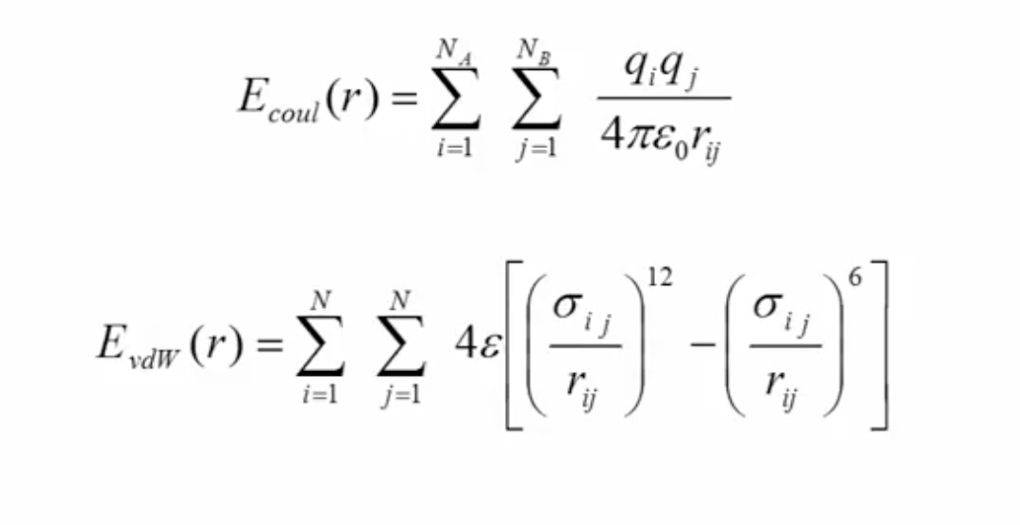
Force field-based scoring functions
Force field is a set of parameters that define the potential energy of a system
They are based on molecular mechanics and estimate the interaction energy between receptor and lignad

Slide 40
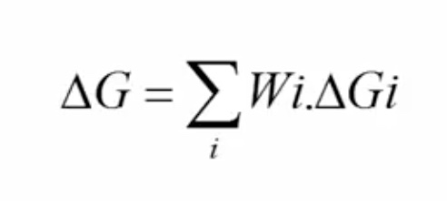
Empirical-based scoring functions
They have simple energy terms and are faster
Hydrogen bonds, ionic interactions, hydrophobic interactions, aromatic interactions, number of rotable bonds
The binding affinity is usually measured as empirical (weighted) sum of all such interactions

Slide 41
Ideally, the best search algorithms and scoring schemes should be combined
Two-stage ranking:
fast scoring to rapidly scan possible solutions and obtain initial "good" candidates – mostly geometric criteria
Followed by more advanced methods to further discriminate the limited conformations - energy criteria
Binding site information (known or predicted) may be included in scoring

Slide 42
Kozakov et al, Biophys J, 2005
Clustering of solutions
Events that occur in clusters are probably not random

Slide 43
Kozakov et al, Biophys J, 2005
Clustering of solutions
The cluster with the largest number of low-energy structures is typically the native fold, the center of the most populated cluster being a structure near the native binding site

Slide 44
Kozakov et al, Biophys J, 2005
Clustering of solutions
Looking for large clusters is a major tool of finding near-native conformations

Slide 45
Challenges & limitations 1
Accurate prediction of ligand-receptor binding energy is still a challenge

Slide 46
Challenges & limitations 2
The process of choosing an appropriate scoring function and algorithm for a specific receptor and ligand is tricky

Slide 47
Challenges & limitations 3
Taking protein flexibility into account is not easy
Proteins are flexible and may undergo even large conformational changes upon binding

Slide 48
Challenges & limitations 4
Desolvation penalty and conformational energy costs are not addressed clearly in most of the scoring functions available

Slide 49
Challenges & limitations 5
Results are generally poor with weakly interacting proteins

Slide 50
Challenges & limitations 6
Accurate interaction energies are too complicated to compute

Slide 51
Conclusions
The molecular docking problem is far from being solved, BUT…
If the conformational change is limited to surface side-chain atoms, rigid body algorithms have been remarkably successful
Integration of experimental information produces reliable results
Relatively easy for enzyme-inhibitor complexes
Sometimes good results with antigen-antibody pairs

Slide 52
Conclusions
The molecular docking problem is far from being solved, BUT…
If the conformational change is limited to surface side-chain atoms, rigid body algorithms have been remarkably successful
Integration of experimental information produces reliable results
Relatively easy for enzyme-inhibitor complexes
Sometimes good results with antigen-antibody pairs

Slide 53
Conclusions
The molecular docking problem is far from being solved, BUT…
If the conformational change is limited to surface side-chain atoms, rigid body algorithms have been remarkably successful
Integration of experimental information produces reliable results
Relatively easy for enzyme-inhibitor complexes
Sometimes good results with antigen-antibody pairs

Slide 54
Conclusions
The molecular docking problem is far from being solved, BUT…
If the conformational change is limited to surface side-chain atoms, rigid body algorithms have been remarkably successful
Integration of experimental information produces reliable results
Relatively easy for enzyme-inhibitor complexes
Sometimes good results with antigen-antibody pairs

Slide 55
Conclusions
The molecular docking problem is far from being solved, BUT…
If the conformational change is limited to surface side-chain atoms, rigid body algorithms have been remarkably successful
Integration of experimental information produces reliable results
Relatively easy for enzyme-inhibitor complexes
Sometimes good results with antigen-antibody pairs

Slide 56
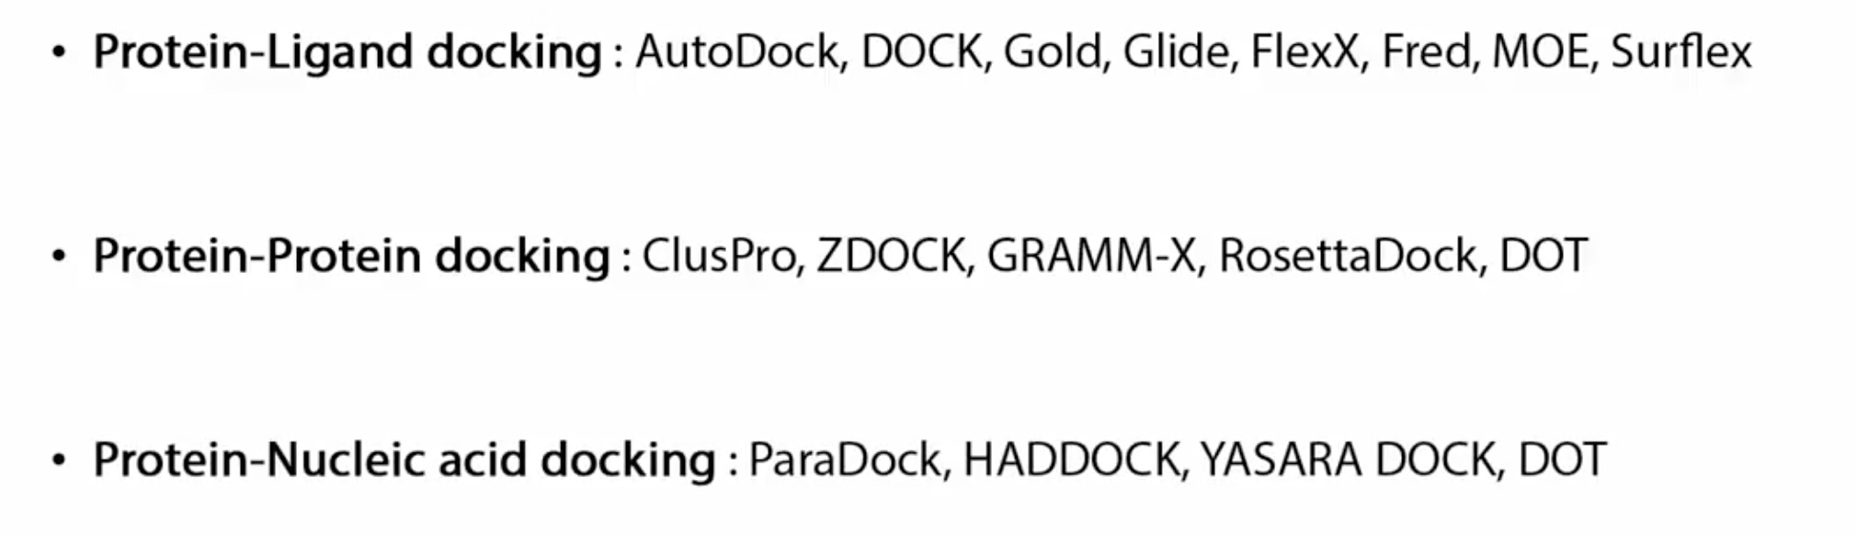
How can you choose a docking program?

Slide 57
How can you choose a docking program?
Who is the receptor?
Who is the ligand?
Is it free?
Is it difficult to use?
How does it perform?
Search algorithm?
Scoring function?

Slide 59
Conclusions
Despite some algorithms are able to rank correct solutions within the top ten predictions, for most complexes the highest ranked structures are still false positives (high rmsd from the complex)
No efficient method for reliable discrimination between correct solutions and FPs is currently available, in particular if the binding site is unknown
Many FPs displaying good surface complementarity are far from the native complex

Slide 60
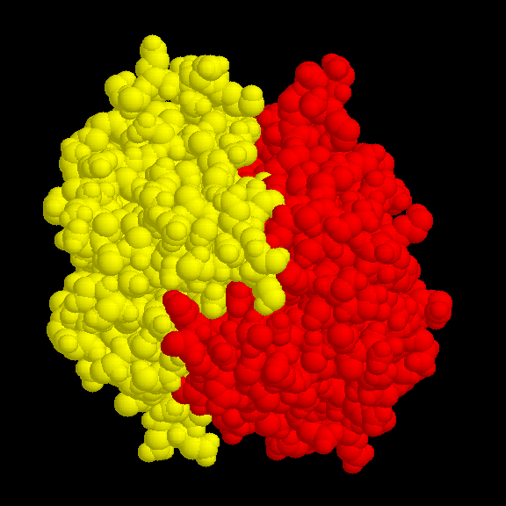
Binary interactions

Slide 61
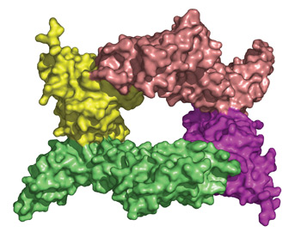
Protein complex
A structural image of the protein-protein complex formed when YpkA (green and pink) binds to the Rac1 protein of the host cell (yellow and purple)

Slide 62
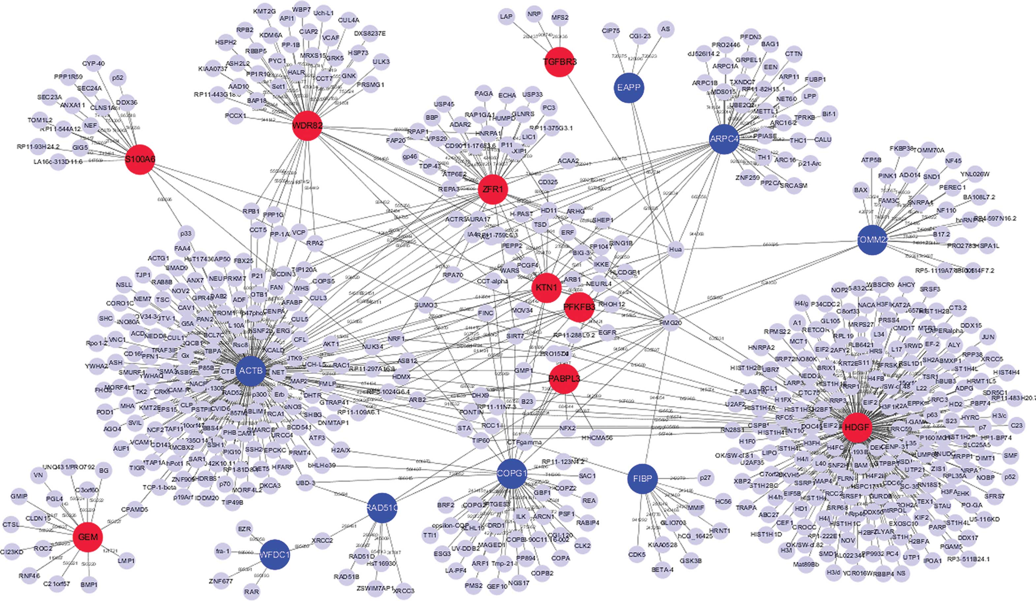
Protein interaction network - hubs

Slide 63
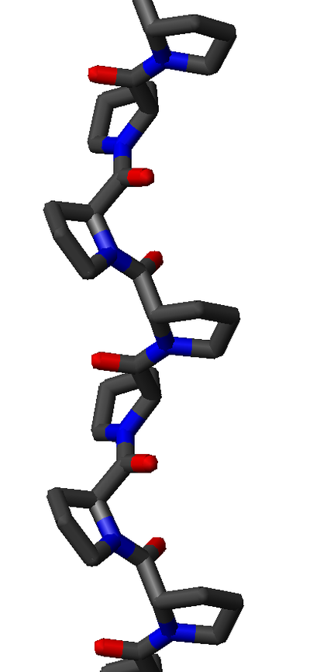
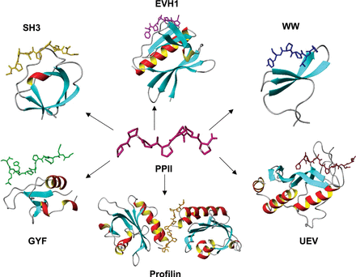
Polyproline type II helices

Slide 64
Strong transient: This category includes interactions that are triggered/stabilised by an effector molecule or conformational change. An example is given by the Ras proteins, which form tight complexes with their partners when GTP-bound and only weak complexes when GDP-bound.
Perkins et al, Structure, 2010

Slide 65
Protein-protein interactions
Transient interactions
Brief and reversible interactions occurring in specific cellular contexts
Stable interactions
Proteins take part of permanent complexes as subunits, in order to carry out structural or functional roles

Slide 66
Examples
Transient interactions
Interactions mediated by short linear motifs
Interactions mediated by PTMs
Disorder-to-order transitions
Proteins involved in signalling cascades
Stable interactions
Homo-oligomeric or hetero-oligomeric complexes
Interactions mediated by PTMs
enzyme-inhibitor
antibody-antigen
domain-domain
domain-peptide
Perkins et al, Structure, 2010

Slide 67
We can classify PPIs according to:
Biological context: enzyme-substrate, antibody-antigen, receptor-hormone/neurotransmitter
Permanence of binding: permanent-obligate vs transient
Similarity of the binding partners: homo vs hetero
Number of binding partners: hub, non-hub
Some of the above categories may partially overlap

Slide 68
Protein-ligand interfaces Structure-function relationship
The ability of proteins to form biologically active complexes depends on the properties of their binding surfaces:
Size
Geometric compatibility
Chemical composition
Polarity
Atom packing efficiency
Hydrogen bond or salt bridge frequency
Number of buried water molecules
Interaction energy
Residue conservation
Types of secondary structures

Slide 69
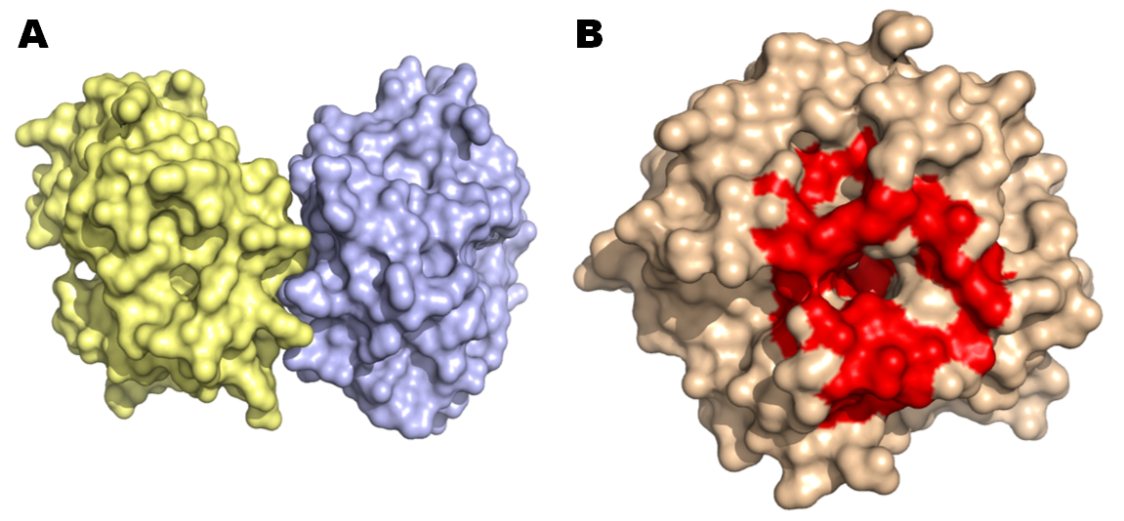
A. Hpx14 homodimer (PDB 3C7X) B. Definition of the docking site (red patch)

Slide 70
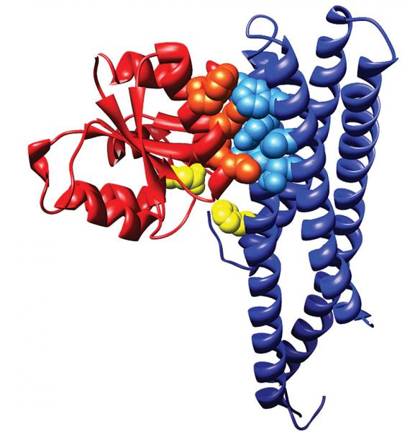
membrane-bound sensor histidine kinase
response regulator
. The catalytic residues that exchange a phosphoryl group are shown in yellow (courtesy of Alexander Schug and Hendrik Szurmant)

Slide 71
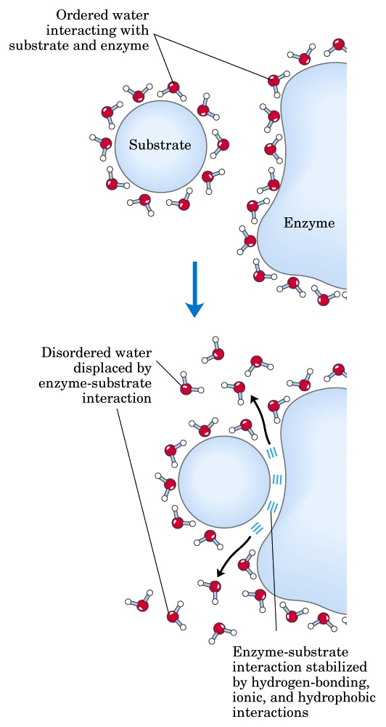
ΔG = ΔH - TΔS
Ligand binding is driven by the hydrophobic effect and van der Waals interactions, whereas electrostatic interactions make them specific
PPI interfaces tend to be more hydrophobic than surfaces that do not participate in the binding
Studies on enzymes demonstrate the importance of the hydrophobic effect also in binding non-protein substrates

Slide 72
Forces governing biomolecular recognition
Van der Waals
Electrostatics
Hydrophobic contacts
Hydrogen bonds
Salt bridges
All interactions act at short range → surface complementarity is needed for tight binding
Efrat Mashiach, http://bioinfo3d.cs.tau.ac.il/

Slide 73
The Binding Site (BS)
Geometry alone is insufficient to recognise the correct ligand
The binding site-ligand match is based on: geometry and electrostatics
Geometric and electrostatic complementarity can be achieved using different BS architectures

Slide 74
PPI surface size
The area of PPI interfaces is large (1000 to 4000 Å²)
Standard-sized interfaces are 1200 to 2000 Å²
Short-lived and low-stability complexes -> smaller interfaces (1150–1200 Å²)
Protein-small molecule interaction surfaces have a smaller area (300 - 1000 Å²).

Slide 75
Other PPI surface features
Flatter than that of other protein-ligand interfaces
Lack the grooves and pockets observed at the surfaces binding small molecules
Generally hydrophobic
Tighter atom packing
Lower polarity
Higher conservation (especially at the center of the interface)

Slide 76
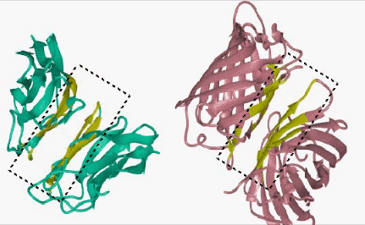
http://home.ku.edu.tr/~okeskin/INTERFACE/INTERFACES.html

Slide 77
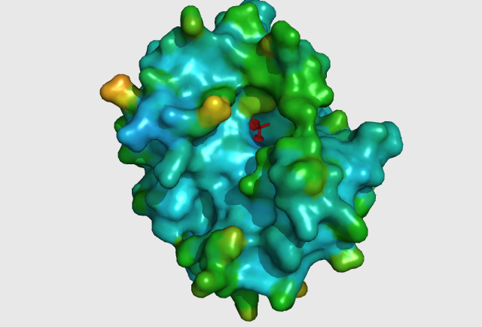
Protein-small molecule: small and deep depressions

Slide 78
Some more facts about PPIs
Transient interfaces differ from stable interfaces
Stable interfaces: less planar, more hydrophobic, better geometric and electrostatic complementarity
Homodimeric interfaces resemble protein cores
Heterodimeric interfaces are more like regular (i.e. non-binding) surfaces

Slide 79
Specificity
Conferred by electrostatic interactions
Electrostatic interactions prevent aggregation (mediated by non-polar interactions)

Slide 80
Protein-ligand binding energetics Protein-ligand affinities
Binding energies may range from -2.5 to -22 kcal/mol
Signal transduction networks -> weak interactions
Cofactor binding by enzymes (reversible but strong) -> -5.5 to -9.5 kcal/mol
Antibody-antigen: -8±3 kcal/mol
Receptor-hormone: -12 kcal/mol
Enzyme-inhibitor: -12±3 kcal/mol
Enzyme-transition state: -22±5 kcal/mol
Kuntz et al., 1999; Zhang&Houk, 2005

Slide 81
Hot spots
The protein-protein binding interface is heterogeneous
Only certain hydrophobic spots contribute to the free energy of binding and help to hold the two proteins together
Affinity seems to result from a small number of residues
Such residues are called hot spots
Hot spots are defined as residues whose replacement by alanine leads to an affinity/free energy change of at least 2 kcal/mol

Slide 82
Some fact about hot spots
Hot spots account for less than 50% of the contact area of PPI
Hot spots tend to be evolutionary conserved
Hot spots tend to appear as clusters in the interface
Some residues are found more frequently in hot spots (e.g., Phe, Tyr, Trp)
Hot spots are surrounded by energetically less important residues that probably separate/prevent bulk water from hot spots

Slide 83
How PPI surfaces can be studied?
Experimental:
The most significant contribution to understanding the PPI surface comes from structural biology via X-ray crystallography or NMR as well as mutational studies
Computational:
Prediction of interaction/binding sites
Prediction of protein-protein complexes
In silico mutational studies

Slide 84
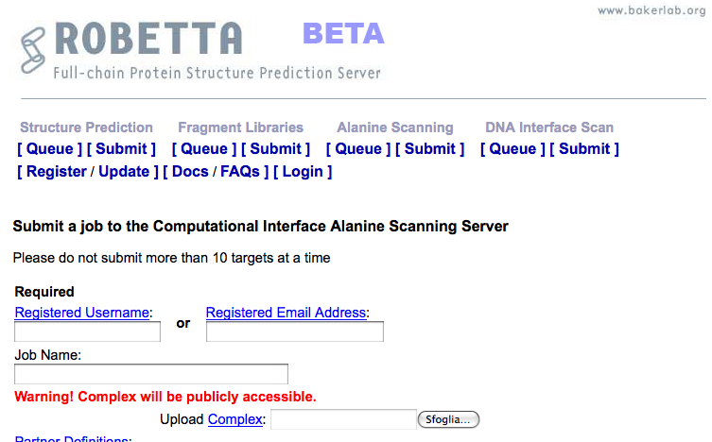
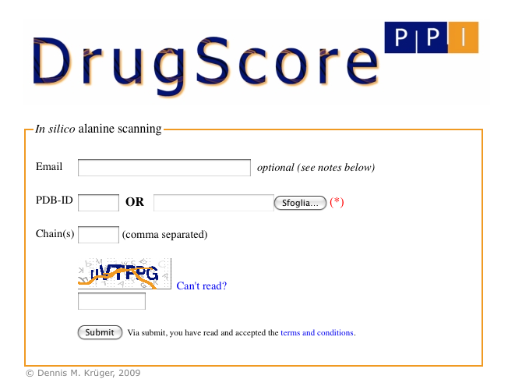
Computational alanine-scanning in protein-protein interfaces
http://robetta.bakerlab.org/alascansubmit.jsp
http://cpclab.uni-duesseldorf.de/dsppi/
DrugScorePPI and Robetta Alascanning are dedicated to the identification of hot spots at protein-protein interfaces

Slide 85
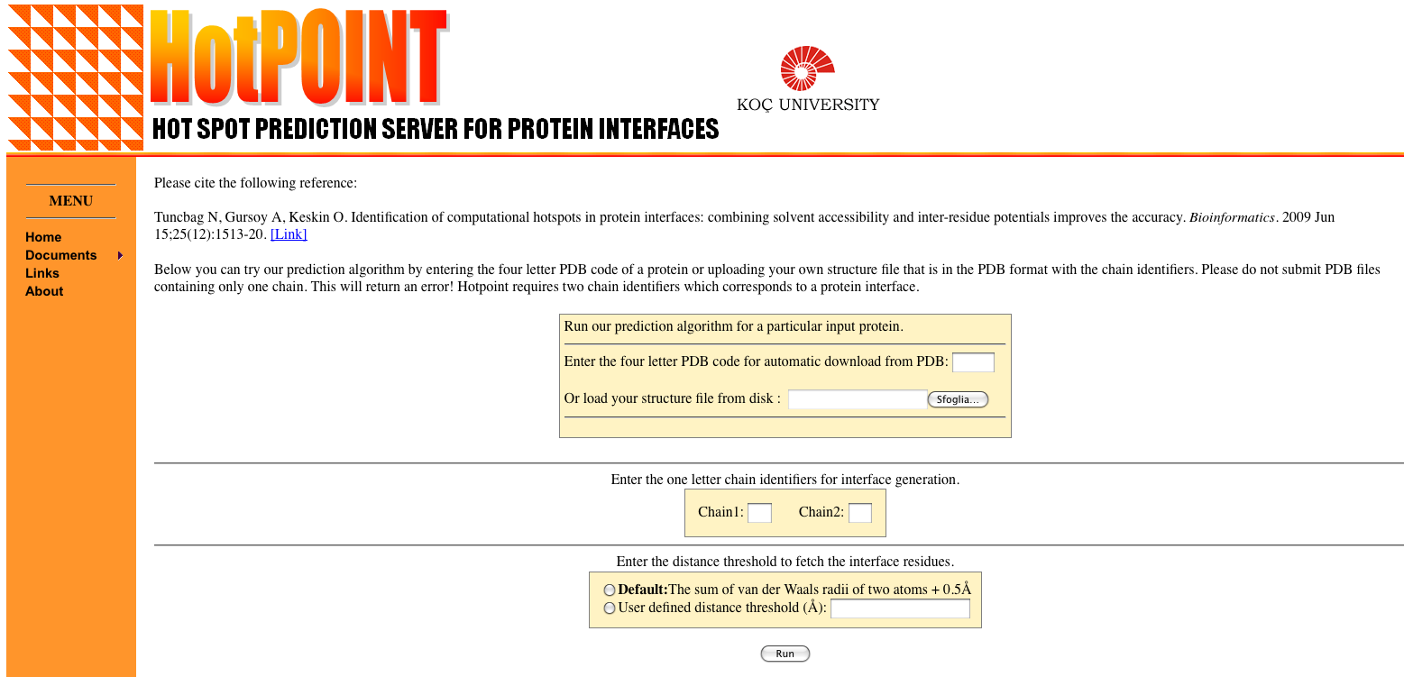
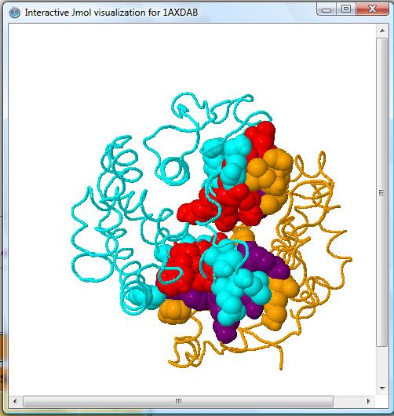
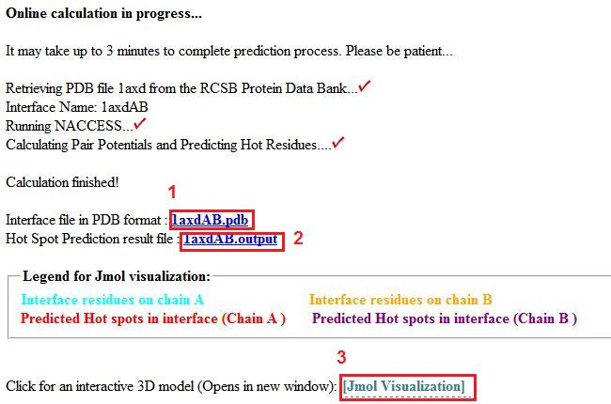
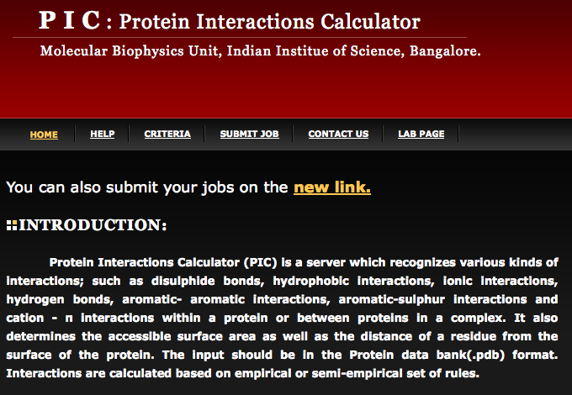
http://prism.ccbb.ku.edu.tr/hotpoint/
HotPOINT calculates solvent accessibilities and total contact potentials. It predicts hot spots at the complex interface
http://crick.mbu.iisc.ernet.in/~PIC/
PIC recognises various kinds of interactions, such as disulphide bonds, hydrophobic interactions, ionic interactions, hydrogen bonds, aromatic- aromatic interactions, aromatic-sulphur interactions and cation-π interactions between proteins in a complex

Slide 86
Prediction of protein-protein interactions
Phylogenetic profiling
Prediction of co-evolved protein pairs based on similar phylogenetic trees
Rosetta stone method
Association methods
Bayesian network modelling
Domain-pair exclusion analysis
Supervised learning problem
Gene fusion
Classification methods
Inference of interactions from homologous structures
Identification of structural patterns (hot spots)
Protein-protein docking
3D

Slide 87
3D modelling of protein complexes

Slide 88
Protein-protein docking: modelling the structure of protein complexes
Used to model protein complexes
It is the “gold standard” for prediction of PPIs
It makes it possible to figure out how the interaction takes place ("mode" of binding)
It is computationally very challenging and thus very unlikely to be applied for high throughput purposes
Ngounou Wetie et al. Proteomics, 2013

Slide 89
What types of questions can docking address?
If receptor and ligand do bind in vivo:
What is the spatial configuration they adopt in their bound state?
What is the structure of the protein complex (near-native structure) in atomic details ?
How strong or weak is their interaction (= which types of interactions are present)?
What is the orientation that maximises the interaction, minimising the energy of the complex?
If they don't bind:
Would they bind if there was a mutation?

Slide 90
Docking prerequisites
The molecular structure (spatial coordinates) of the interacting partners
has been determined experimentally
or
can be "safely" predicted
Computing power

Slide 91
"Bound" docking
Tries to reconstruct a complex using the bound structures of the receptor and the ligand
After artificial separation of the receptor and the ligand, the goal is to reconstruct the native complex
No conformational changes are involved
Used as first test to validate the algorithm

Slide 92
"Unbound" or "predictive" docking
Tries to reconstruct a complex using the unbound structures of the receptor and the ligand
An "unbound" structure maybe a native structure, a pseudo-native structure, or a modelled structure
Native: free in solution, in its uncomplexed state
Pseudo-native: structure complexed with a molecule different from the one used for the docking
Halperin et al. Proteins, 2002

Slide 93
Unbound docking
It is far more complex than bound docking
Problems:
conformational changes (side-chains and backbone movements)
experimental errors in the structures
reliability of models

Slide 94
The three key ingredients in docking
Representation of the system
Conformational space search
Ranking of potential solutions

Slide 95
The three key ingredients in docking
Representation of the system

Slide 96
Representation of the system
Docking essentially simulates the interaction of the protein surface
How do we define a protein surface?
Mathematical models (e.g. geometrical shape descriptors, a grid)
Static or dynamic treatment of the protein frame (rigid vs flexible)

Slide 97
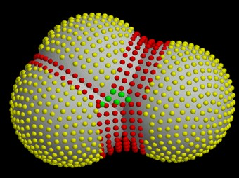
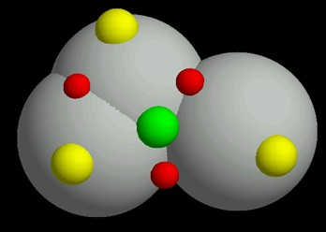
Surface representation
Dense surface (Connolly)
Sparse surface (Shuo Lin et al.)
The choice of the system (surface) representation decides the types of conformational search algorithms, and the ways to rank potential solutions
http://www.chem.leeds.ac.uk/ICAMS/eccc/cangaroo.html

Slide 98
The three key ingredients in docking
Representation of the system
Conformational space search

Slide 99
Conformational space search
Efficient search algorithm – fast and effective in covering the relevant conformational space
Computationally difficult - there are many ways to put two molecules together (3 translational + 3 rotational degrees of freedom)
Goal: locate the most stable state (global minimum) in the energy landscape

Slide 100
Rigid vs flexible docking
Rigid body - highly simplistic model regarding the two proteins as two rigid solid bodies
Semi-flexible - one of the molecules is considered flexible, while the receptor is regarded as rigid
Flexible docking – both molecules are considered flexible, though flexibility is limited or simplified

Slide 103
ClusPro http://nrc.bu.edu/cluster
The first fully automated, web-based program for the computational docking of protein structures
The docking algorithms evaluate billions of putative complexes, retaining a preset number with favorable surface complementarities
A filtering method is then applied to this set of structures, selecting those with good electrostatic and desolvation free energies for further clustering
The program output is a short list of putative complexes ranked according to their clustering properties

Slide 104
ClusPro http://nrc.bu.edu/cluster
User Input: PDB files of the 2 protein structures
Output: 10 (default) top predictions of docked conformations close to the native structure
Rigid body docking is performed using 2 established FFT-based docking programs (DOT and ZDOCK)
The scoring is solely based on the surface complementarity between the two structures
Over 2.7 10¹⁰ structures are evaluated, retaining 20 000 structures with the best surface complementarity scores, which are then further subjected to an empirical free energy filtering algorithm

Slide 105
ClusPro http://nrc.bu.edu/cluster
The free energy of the complex structure is typically dominated by van der Waals interactions, which is a very noisy function and difficult to calculate, especially with incorrect side-chain rotamers
Therefore, other components of the binding free energy are used to account for the noise of the van der Waals energies
Desolvation free energy using the atomic contact potential (statistical measure of the desolvation free energy)
Electrostatic free energy using a Coulombic model with a distance-dependent dielectric of 4r

Slide 106
ClusPro http://nrc.bu.edu/cluster
The top 2000 energetically favorable structures are clustered on the basis of a pairwise binding site root mean squared deviation (RMSD) criterion
Clusters are then formed by selecting the ligand that has the most neighbors below a previously selected clustering radius.
The ligand with the most neighbors is the cluster center, and is the representative structure for the cluster

Slide 107
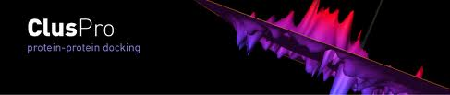
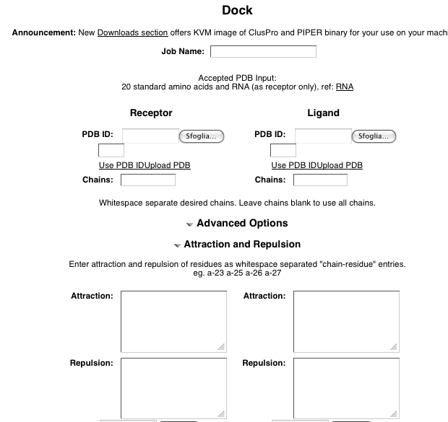

Slide 109
The HADDOCK protocol
Rigid-body docking followed by
a semi-flexible refinement of the interface in torsion angles' space (of both backbone and side-chains)
as a final stage, a Cartesian dynamics refinement in explicit solvent

Slide 110
The HADDOCK services
the Easy interface
the Prediction interface
the Expert interface (requires Expert level access)
the Refinement interface (requires Expert level access)
the Guru interface (requires Guru level access)
the Multi-body interface (requires Guru level access)
the File upload interface

Slide 111
The EASY interface

Slide 112
The EXPERT interface

Slide 113
The GURU interface

Slide 114
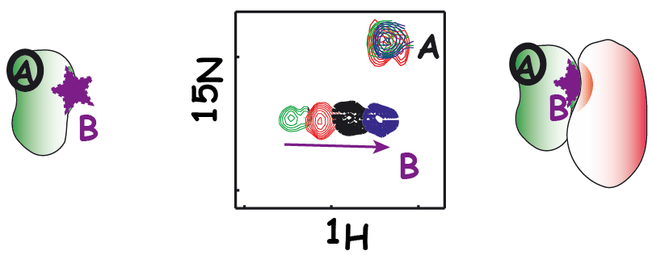
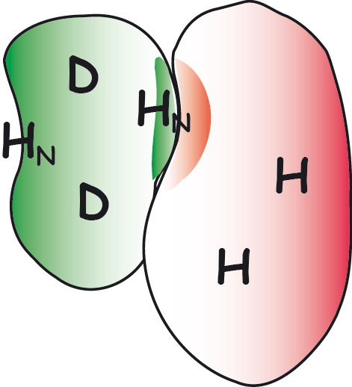
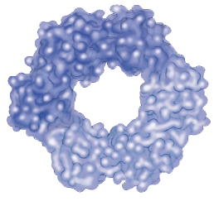
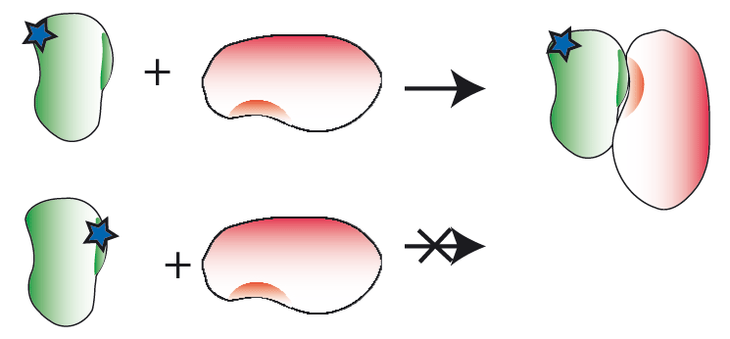
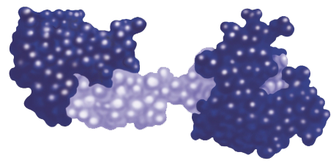
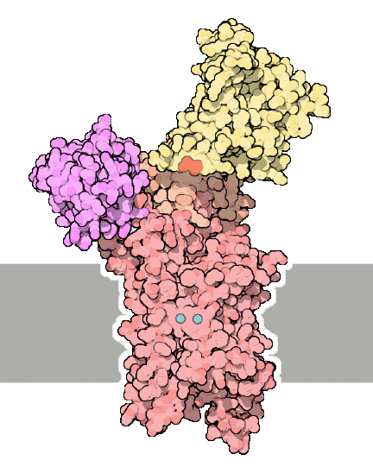
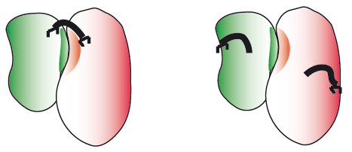
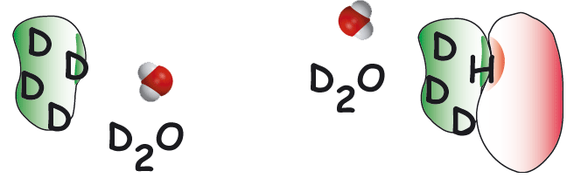
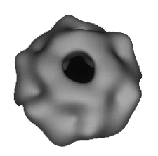
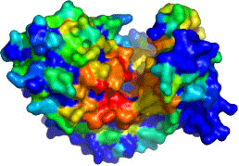
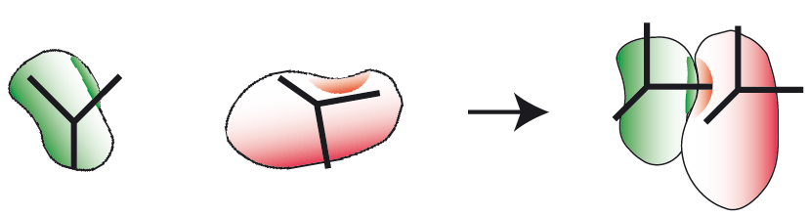
NMR titrations
NMR crosssaturation
mutagenesis
Cross-linking
HADDOCK
High Ambiguity Driven DOCKing
x
B
y
j
z
H/D exchange
A
i
k
d_{iAB}^{eff}
Other sources
e.g. SAXS, cryoEM
Bioinformatic predictions
EFRGSFSHL
EFKGAFQHV
EFKVSWNHM
LFRLTWHHV
IYANKWAHV
EFEPSYPHI
NMR anisotropy data
RDCs, para-restraints, diffusion anisotropy
http://haddocking.org; http://www.nmr.chem.uu.nl/haddock

Slide 115
Parameters supported by the various HADDOCK web interfaces
de Vries et al., Nature Protocols, 2010

Slide 116
Example of HADDOCK output
In this case additional experimental information has to be taken into account to completely rule out alternatives to the highest-scoring solution
In this case additional experimental information has to be taken into account to completely rule out alternatives to the highest-scoring solution
de Vries et al., Nature Protocols, 2010
Notes:
The top structure of the top cluster hase an interface RMSD of only 1.1 A to the first model of NMR structure. The second cluster in which oner component is 90° rotated has an HADDOCK score very similar, therefore in this case additional experimental information has to be taken into account to completely rule out alternatives to the highest-scoring solution.

Slide 117
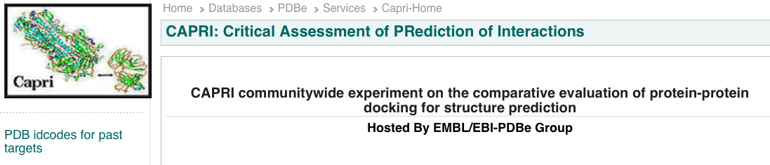
CAPRI: Critical Assessment of PRotein Interactions
http://www.ebi.ac.uk/msd-srv/capri/
CAPRI is a community-wide experiment in modelling the molecular structure of protein complexes
CAPRI is a blind prediction experiment aimed at testing the performance of protein docking methods
Rounds take place about every six months
Each round contains between one and six target protein–protein complexes whose structures have been recently determined experimentally
Targets are unpublished crystal or NMR structures of complexes, whose coordinates are held privately by the assessors, with the co-operation of the structural biologists who determined them
The atomic coordinates of the two proteins are given to groups for prediction

Slide 118

CAPRI: Critical Assessment of PRotein Interactions
The CAPRI experiment is double-blind
submitters do not know the solved structure
the assessors do not know the correspondence between a submission and the identity of its creator
International meetings
Proteins: Structure, Function, and Bioinformatics
Special CAPRI Issue: Fifth Meeting on the Critical
Assessment of Predicted Interactions
December 2013

Slide 119
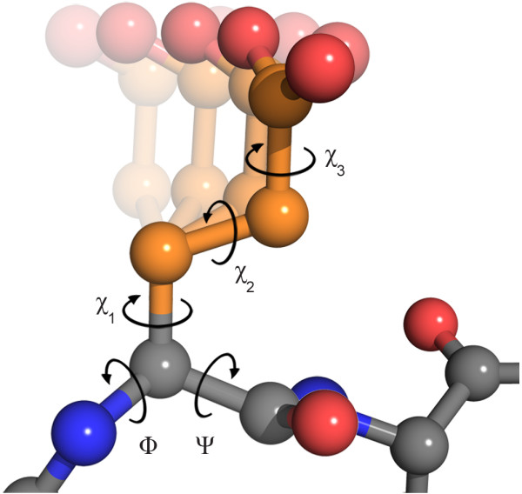
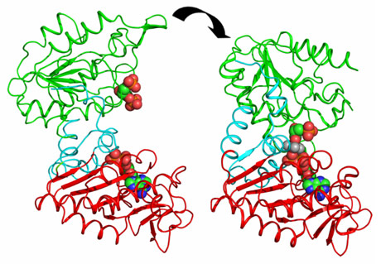
CAPRI drives the community to develop new techniques
Side-chain flexibility
First rounds the big challenge was to model correctly side-chain conformations
Dihedral angles in glutamate
Domain movements
Today the development is focused on backbone flexibilty
Domain movements in PGK catalysis.
J. Biol. Chem. (2011) 286, 14040-14048
The clustering application to protein-protein docking was first introduced in CAPRI by Camacho & Gatchell,D. (2003)

Slide 120

CAPRI experiment … who is the winner ??
There is no official ranking and in many cases the differences between the different algorithms are not huge

Slide 121
CAPRI experiment … who is the winner ??
HADDOCK (software/web server). http://haddock.chem.uu.nl
CLUSPRO (software/web server)
http://cluspro.bu.edu
ICM-pro (desktop-modeling environment)
http://www.molsoft.com/protein_protein_docking.html
ROSETTADOCK (software/web server) http://graylab.jhu.edu/docking/rosetta/
http://rosettadock.graylab.jhu.edu/submit
GRAMM-X (web server) http://vakser.bioinformatics.ku.edu/resources/gramm/grammx
PATCHDOCK/FIREDOCK (software/web server) http://bioinfo3d.cs.tau.ac.il/PatchDock/
HEX (software/web server) http://hexserver.loria.fr

Slide 122
Course materials
https://github.com/aidanbudd/ppisnd/tree/gh-pages/trainingMaterial/allegraVia
Suggested readings:
La et al. Predicting permanent and transient protein-protein interfaces. Proteins 2013
Perkin et al. "Transient Protein-Protein Interactions: Structural, Functional, and Network Properties" Structure 2010
Bendell et al. Transient protein-protein interface prediction: datasets, features, algorithms, and the RAD-T predictor. BMC Bioinformatics 2013

Slide 123
Parameters used for scoring
Geometric complementarity - how to score complementarity is strongly coupled with the surface representation
Intermolecular overlap – tolerance to slight interface clashes and penalty for protein interior clashes (surface "belt" of nonpenalised penetration area)
Intra-molecular overlap – when backbone flexibility is taken into account
Hydrogen bonding
Contact area: total interactions = hh + pp + hp (h = hydrophobic, p = polar)
Pairwise aa and atom-atom contacts – empirical term derived form observed statistical frequency of aa contacts in X-ray proteins
Electrostatic interactions and solvation energy

